Slide 1


StaffEase
Second Year Project Synopsis
Submitted by
ROLL | NAME
2301010240 | Rucchika Kapoor
2301010216 | Sarthak Kumar
2301010268 | Raghuveer Diya
2301010253 | Ayush Hatwal
Industry Mentor : Mr Priyank Sharma
Faculty Mentor : Dr Radhika Gupta
Notes:
New Courses replaced with New Programmes

Slide 2

OBJECTIVE
The objective of this project is to design and develop a comprehensive Employee Management System (EMS) that enables small to medium enterprises (SMEs) to efficiently manage employee information, attendance, departments, and salaries through a user-friendly web interface.
The system integrates a secure login mechanism, a structured backend using Node.js and SQLite, and an intuitive frontend built with HTML, CSS, and JavaScript, allowing administrators to perform CRUD operations, monitor employee performance, and ensure data integrity across modules.
Notes:
New Courses replaced with New Programmes

Slide 3
Project Overview
The Employee Management System (EMS) is a web-based platform designed to simplify and streamline the administrative tasks involved in managing employees within an organization.
It provides functionalities such as secure login authentication, employee record management, attendance tracking, department monitoring, and salary management.
The EMS ensures that data is stored reliably using a lightweight SQLite database and offers a responsive and easy-to-use interface developed using HTML, CSS, and JavaScript, while the backend operations are managed through Node.js and Express.js.
This system targets small and medium-sized enterprises (SMEs) that require a cost-effective, scalable solution to manage their workforce efficiently without relying on manual paperwork or outdated systems.
Notes:
New Courses replaced with New Programmes

Slide 4
Problem Statement
Many small and medium-sized enterprises (SMEs) face difficulties in maintaining and managing employee records, tracking attendance, and managing departmental structures efficiently due to:
• Manual record-keeping, leading to errors and inefficiencies.
• Lack of centralized access to employee information.
• Poor security practices, risking unauthorized access to sensitive data.
• Time-consuming processes for updating, retrieving, and managing data.
• Limited budget and resources to deploy expensive enterprise-grade HR software.
Notes:
New Courses replaced with New Programmes

Slide 5
Methodology, Tools, and Techniques
Approach:
- Requirement gathering ➔ System design ➔ Development ➔ Testing ➔ Deployment
Tools and Software:
• Frontend: HTML5, CSS3, JavaScript
• Backend: Node.js, Express.js
• Database: SQLite3
• Development Tools: Visual Studio Code (VS Code), npm (Node Package Manager)
Notes:
New Courses replaced with New Programmes

Slide 6
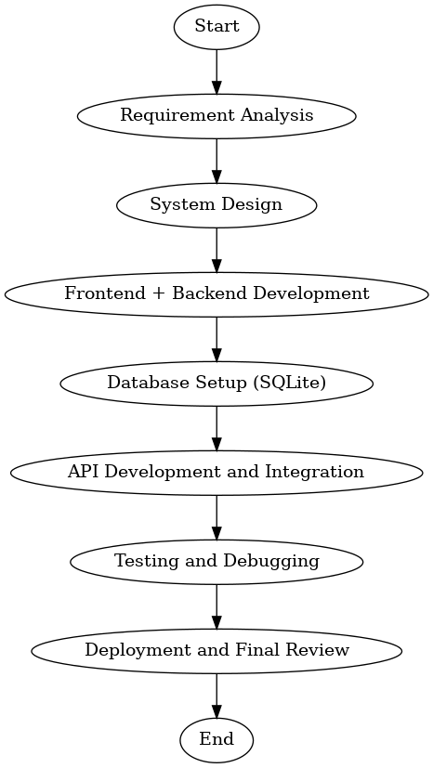
Methodology Flowchart
Notes:
New Courses replaced with New Programmes

Slide 7
Project Timeline
- Requirement Analysis: 1 week
- Design and Planning: 1 week
- Frontend Development: 2 weeks
- Backend Development: 2 weeks
- Integration & Testing: 1 week
- Final Deployment & Review: 1 week
Total Duration: 8 Weeks
Notes:
New Courses replaced with New Programmes

Slide 8
Expected Results & Impact
Expected Results:
A user friendly system that simplifies managing employee data.
Improved efficiency in managing employing data including personal information,job roles & documents.
Impact:
• Automates employee management tasks, improving efficiency.
• Enhances data security and accuracy with centralized storage.
• Provides a low-cost solution for small and medium enterprises.
Notes:
New Courses replaced with New Programmes

Slide 9
References
ReactJS Documentation – https://react.dev
Spring Boot Documentation– https://spring.io/projects/pring-boot
MySQL Official Documentation– https://dev.mysql.com/doc/
Notes:
New Courses replaced with New Programmes

Slide 10
THANK YOU

